Slide 1
2024- 23nd Annual

Slide 2
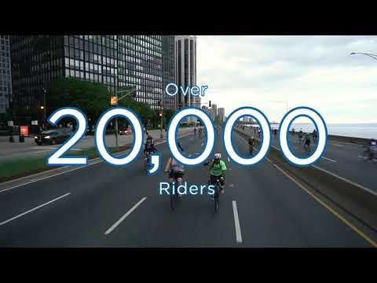

Slide 3
Shirts
Managers will be wearing
Volunteers will wear
orange
green
tech tees

Slide 4
Whoa Whoa...
I’m totally gonna forget this information! Where can I find it?

Slide 5
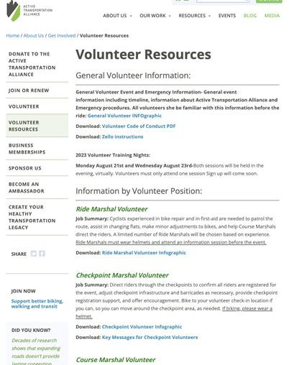
Volunteer Resources Page
Information for each volunteer position Including infographics, videos and additional messaging
Website: https://activetrans.org/about- us/get-involved/volunteer- resources

Slide 6
Text BIKETHEDRIVE VOLS to
52886
To receive important info or emergency notices

Slide 7
Volunteer Infographics
Printed Infographic handout!
Nuanced info such as:
Where do I find a bathroom?
What is this event?
What should I be doing?
Emergency Procedures?
What should I say to the riders?

Slide 8
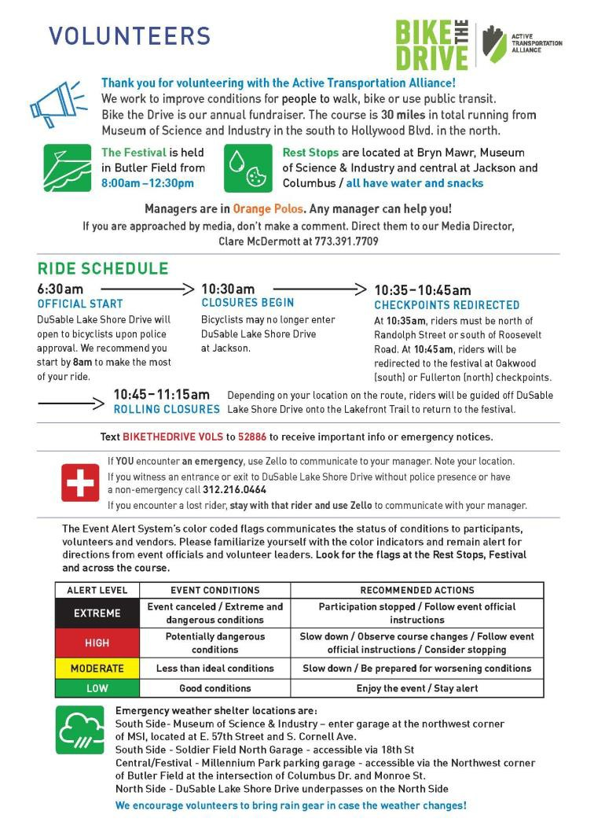
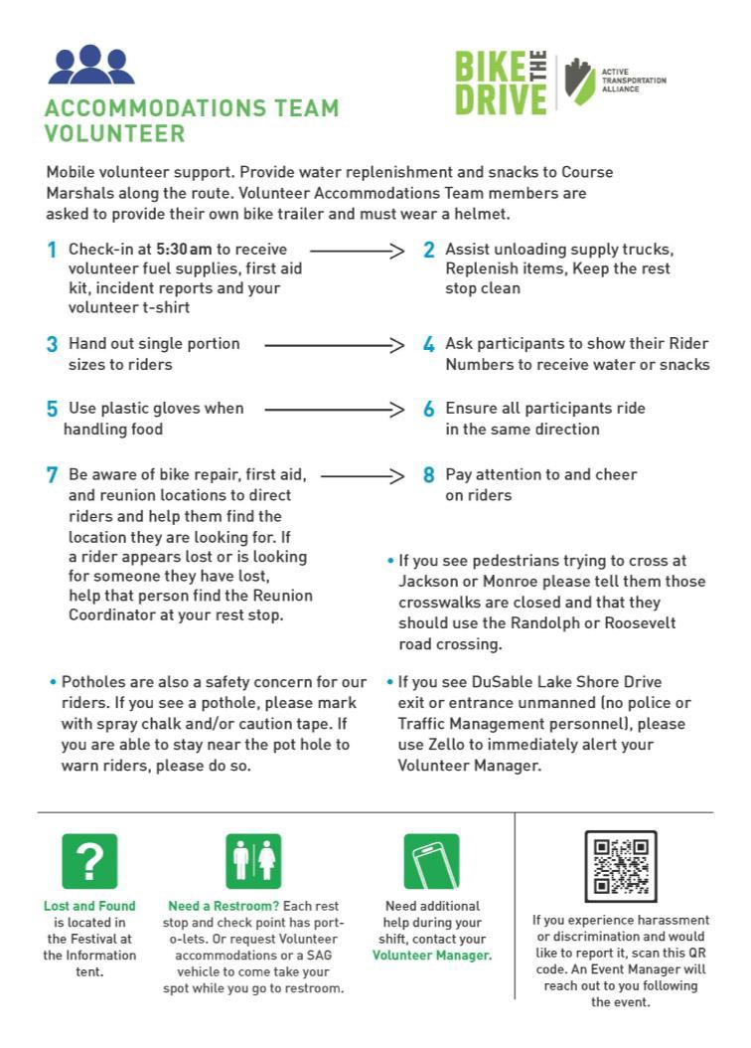

Slide 9
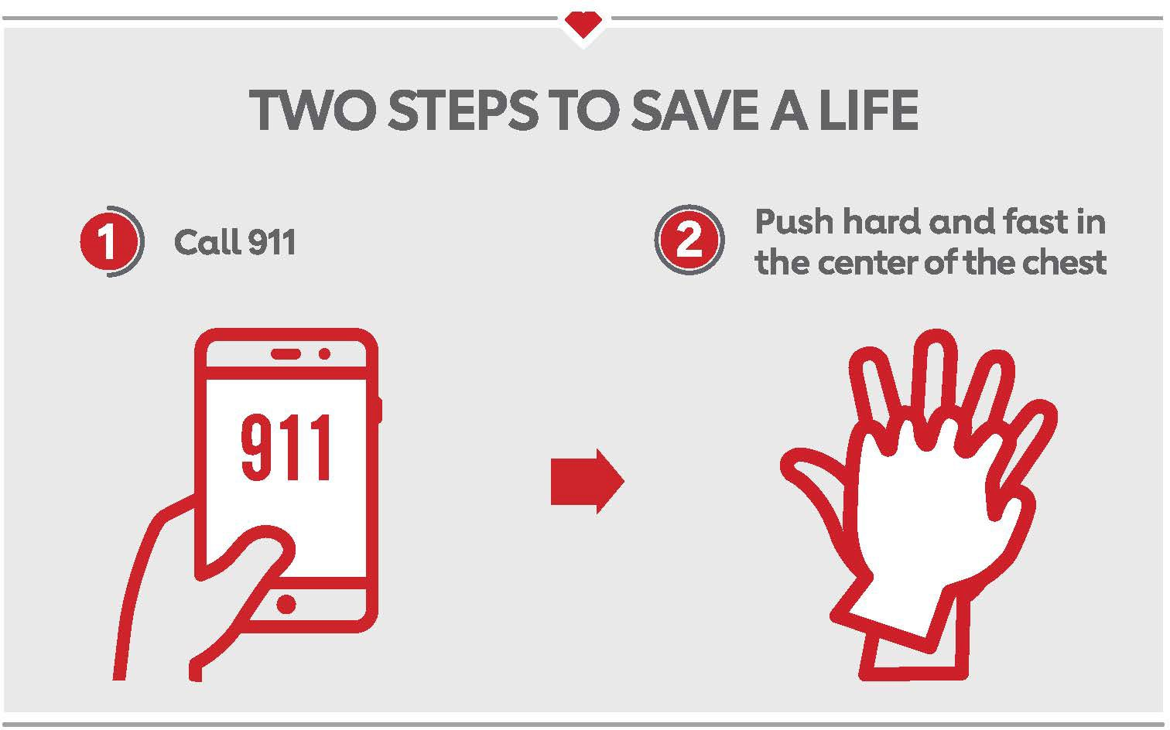
Hands Only CPR Training

Slide 10
Split up!
Festival will stay in the main room
Route will move into a breakout with Brittany

Slide 11
Festival!

Slide 12
Volunteer Managers
They’ll be wearing orange polos.
All volunteers are required to check
in and out.
Volunteers will be sent the following info BEFORE volunteer shift:
Exact location
Check in time
Manager contact
information/cell phone
Volunteer
Managers
Check in/out Location:
Grant Park/Butler Field – Festival
location

Slide 13
7:00am: Vendor and Exhibitor Set-up
6:30 am – Bike the Drive starts with Police “all clear” Cyclists start to the north and to the south
FESTIVAL SCHEDULE
8:00am: Festival Opens
11:30am: Festival Breakdown begins
12:00 pm – Car traffic fully restored to Lake
Shore Drive
**11:30 - 12:30 pm – Jackson remains closed to car traffic between Columbus and Lake Shore Drive for Bike the Drive Post-Ride Festival
12:30p-All streets returned to regular car
traffic

Slide 14
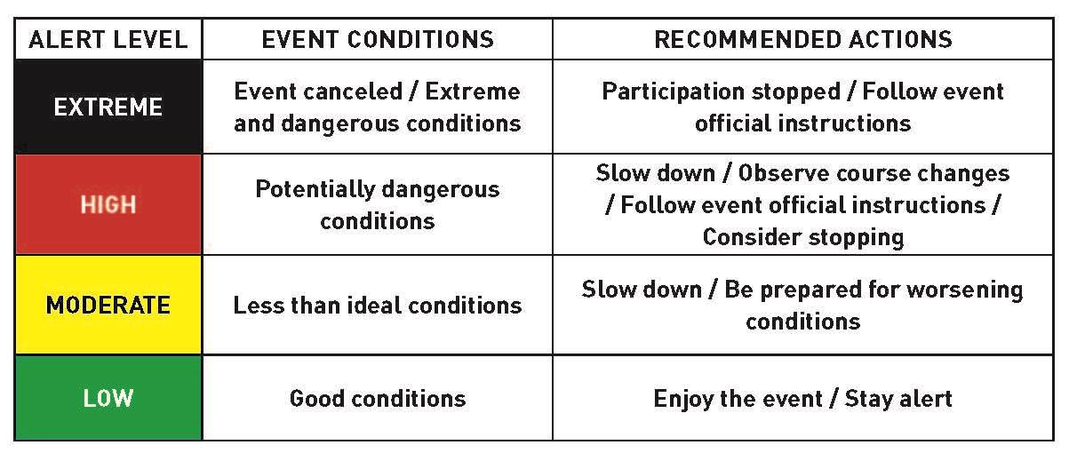
Safety and Security
EAS (Event Alert System – color coded flags) – used by the Marathon and other major events. 12 flag systems spread across event & festival. We are also implementing airhorns. 3 short blasts will alert all to tune into Zello/texts
Security Presence – If you encounter a rowdy or unsafe participant you can alert nearby Security or ask your manager to call (via Zello) for security

Slide 15
Festival Facts and Changes
We are excited to Welcome back Cafe Tola!
DJ instead of live band
Day of Registration and Shirt Tents are located in the bandshell.
DAT Donuts will be donut vendor again this year! For the entire route and Festival!!

Slide 16
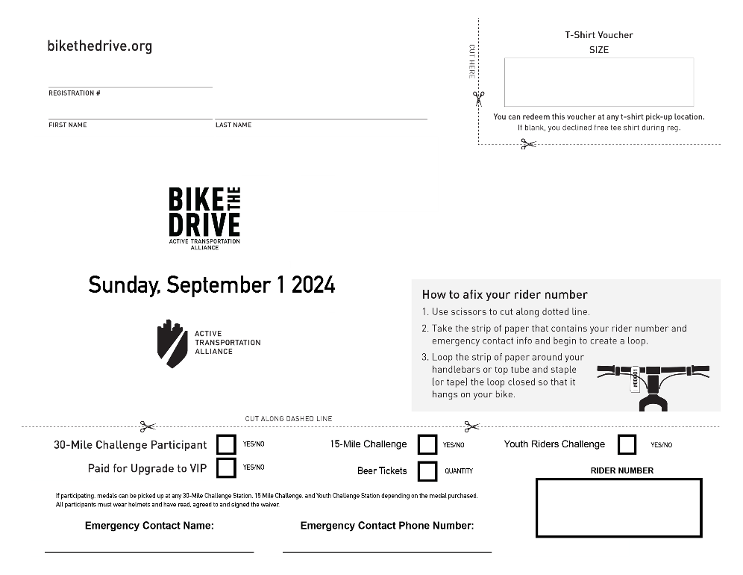
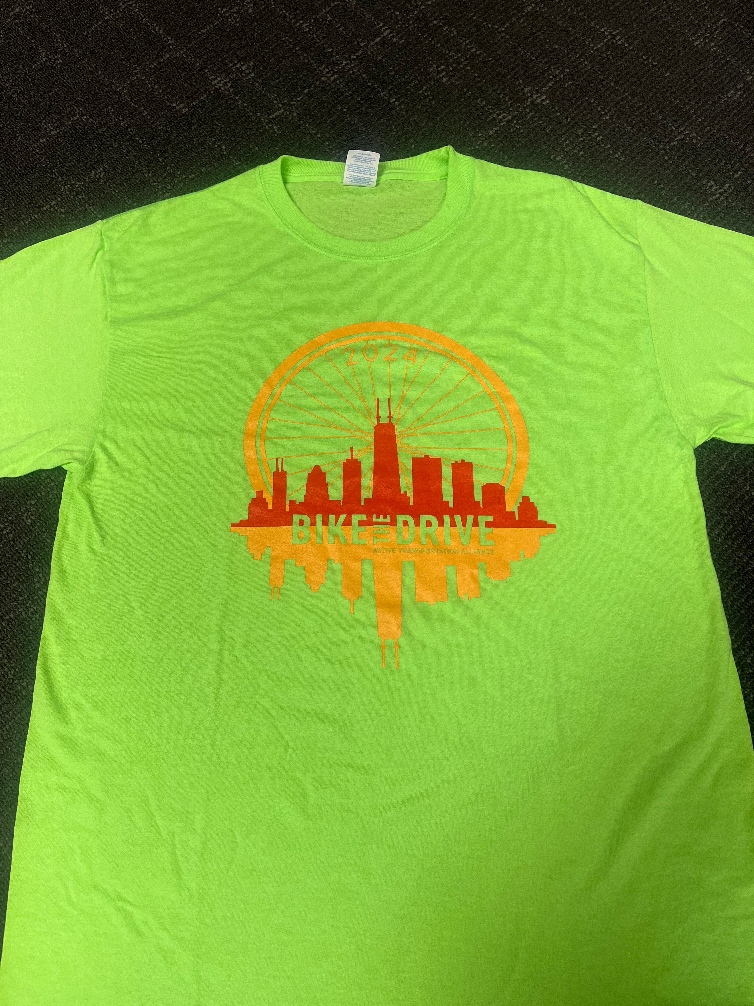
E-Tickets & T-shirt Pick Up
T-Shirts, Challenge medals & ride guides can be picked up at the following locations:
North Rest Stop
South Rest Stop
Festival

Slide 17
BIKE THE DRIVE
GATORADE - PRODUCT TALKING POINTS
GATORLYTE
"Rapid Rehydration"
Made with a specialized blend of 5 electrolytes (sodium, potassium, magnesium, chloride, and calcium)
Made with no artificial sweeteners or flavors
GATORADE FIT
"Healthy Real Hydration"
100% daily value for vitamins A and C
Electrolytes from watermelon juice and sea salt
No added sugar
No artificial flavors or sweetners
GATORADE WATER
"Gatorade's first ever unflavored water for all day hydration"
"Infused with electrolytes for great taste"
Alkaline (pH of 7.5 or higher)

Slide 18
How can we have THIS much fun?
We’re a community! We’re all here to make sure BTD is enjoyable
If you aren’t sure...ask
Rules/Guidelines (ask your manager)
Everyone’s Pronouns
(he/she/they)
Lead with kindness to riders. If someone isn’t registered encourage them to do so. But if they don’t we will offer them
grace & let them continue.

Slide 19
Questions?
Specific Questions: volunteer@activetrans.org

Slide 20
Route Positions!

Slide 21
All volunteers are required to check in and
out with their Volunteer Manager.
Volunteers will be sent the following info BEFORE volunteer shift:
1. Exact location 2. Check in time
3. Manager contact information/cell phone
Volunteer Managers
Check in/out Locations: Depending on your position, there are five check-in locations
Grant Park/Butler Field- Ride Marshals and Course Marshals ONLY
Bryn Mawr Rest Stop – Bryn Mawr and Dusable Lake Shore Drive
Museum of Science and Industry – 57th Street and DLSD
Oakwood Rider Check – East Side of
Dusable Lake Shore Drive at Oakwood
Fullerton Rider Check- East side of DLSD at Fullerton
They’ll be wearing
orange
polos.

Slide 22
6:00 am – DuSable Lake Shore Drive cleared of car traffic by the Chicago Police
6:30 am – Bike the Drive start time with Police “all clear” (communicated by radio to our Event Manager, Brittany Gillespie). Cyclists start to the north and to the south
6:35 to 10:25 am – Riders pass through Fullerton and Oakwood checkpoints
10:25 am – Bicycle sweeps dispatched from Grant Park/Butler Field
10:25 am – No rider passes Grant Park/Butler Field after this time
10:30 am – Fullerton and Oakwood rider checkpoints
dismantled
10:30 am – No rider passes Monroe/DuSable Lake Shore Drive after this time
ROUTE SCHEDULE

Slide 23
10:30 am – Bicycle sweeps dispatched from North & South
10:35 am - The last SB riders should pass Roosevelt, having headed south from Jackson at 10:35 am
10:35 am – The last NB riders should pass Randolph, having headed north from Jackson at 10:35 am
10:45 am – Riders are directed inbound at Fullerton and Oakwood
11:15 am – Riders will be directed off DuSable Lake
Shore Drive all along the route
11:30 to 11:45 am – Car traffic fully restored to DuSable Lake Shore Drive
11:30 - 1:00 pm – Jackson remains closed to car traffic
ROUTE SCHEDULE CONT.

Slide 24
Safety and Security
EAS (Event Alert System – color coded flags) – used by the Marathon and other major events. 12 flag systems spread across event & festival. We are also implementing airhorns. 3 short blasts will alert all to tune into Zello/texts
City (snow plows/garbage trucks, camera connectivity to DLSD surveillance,)
Enhanced info about Lakefront Trail Usage & safety tips!
Potholes are also a safety concern for our riders. Zello a Ride Marshal to mark with spray chalk. If you are able to stay near the pothole to warn riders, please do
so.
Barricades – after the event concludes, if you’re directed to move a barricade, please move it from the public walkways or foot paths so it’s not a tripping hazard.
If you see DuSable Lakeshore Drive exit or entrance unmanned or without a vehicle (no police or Traffic Management personnel), please use Zello and/or
CALL communications tent immediately

Slide 25
Safety and Security Enhancements
Blue Star Security – we’ve contracted with Blue Star for 8 off-duty officers that can be used as our rapid response team and to help fill gaps.
Route Captain Lead & Captains – Route Captain Lead will oversee a team of 6 Route Captains. Their primary job is route safety and
oversight they will work closely with Ride Marshal and Course
Marshals
Safety Shelters – We’ve expanded our safety shelters to now include MSI and Soldier Field North Parking Garages in addition to Millennium Parking (north side is under DLSD underpasses)

Slide 26
Communication
We are continuing with Zello app!
This allows seamless communication between route positions.
We recommend using headphones for better audio.
Text Messaging Platform
We will more heavily rely on our mass text messaging system for participant communication such as pre-ride reminders and any important day of info!
5/3 Bike the Drive App!
We have an app! All of the information for participants can be downloaded!

Slide 27
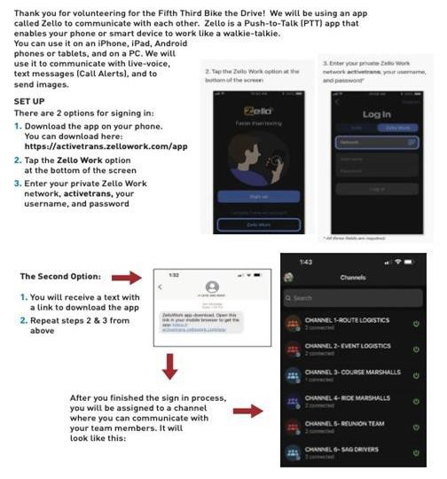
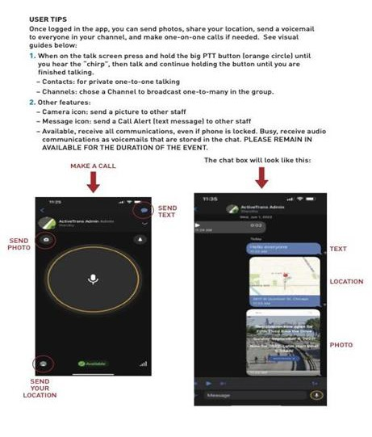

Slide 28
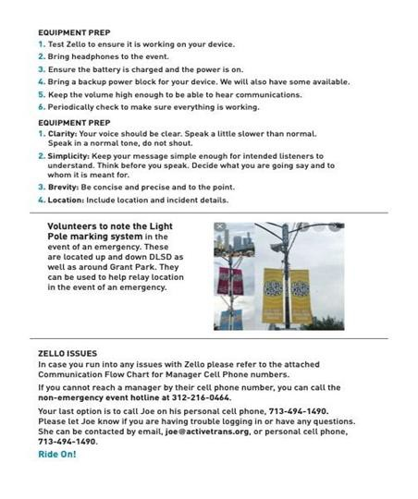

Slide 29
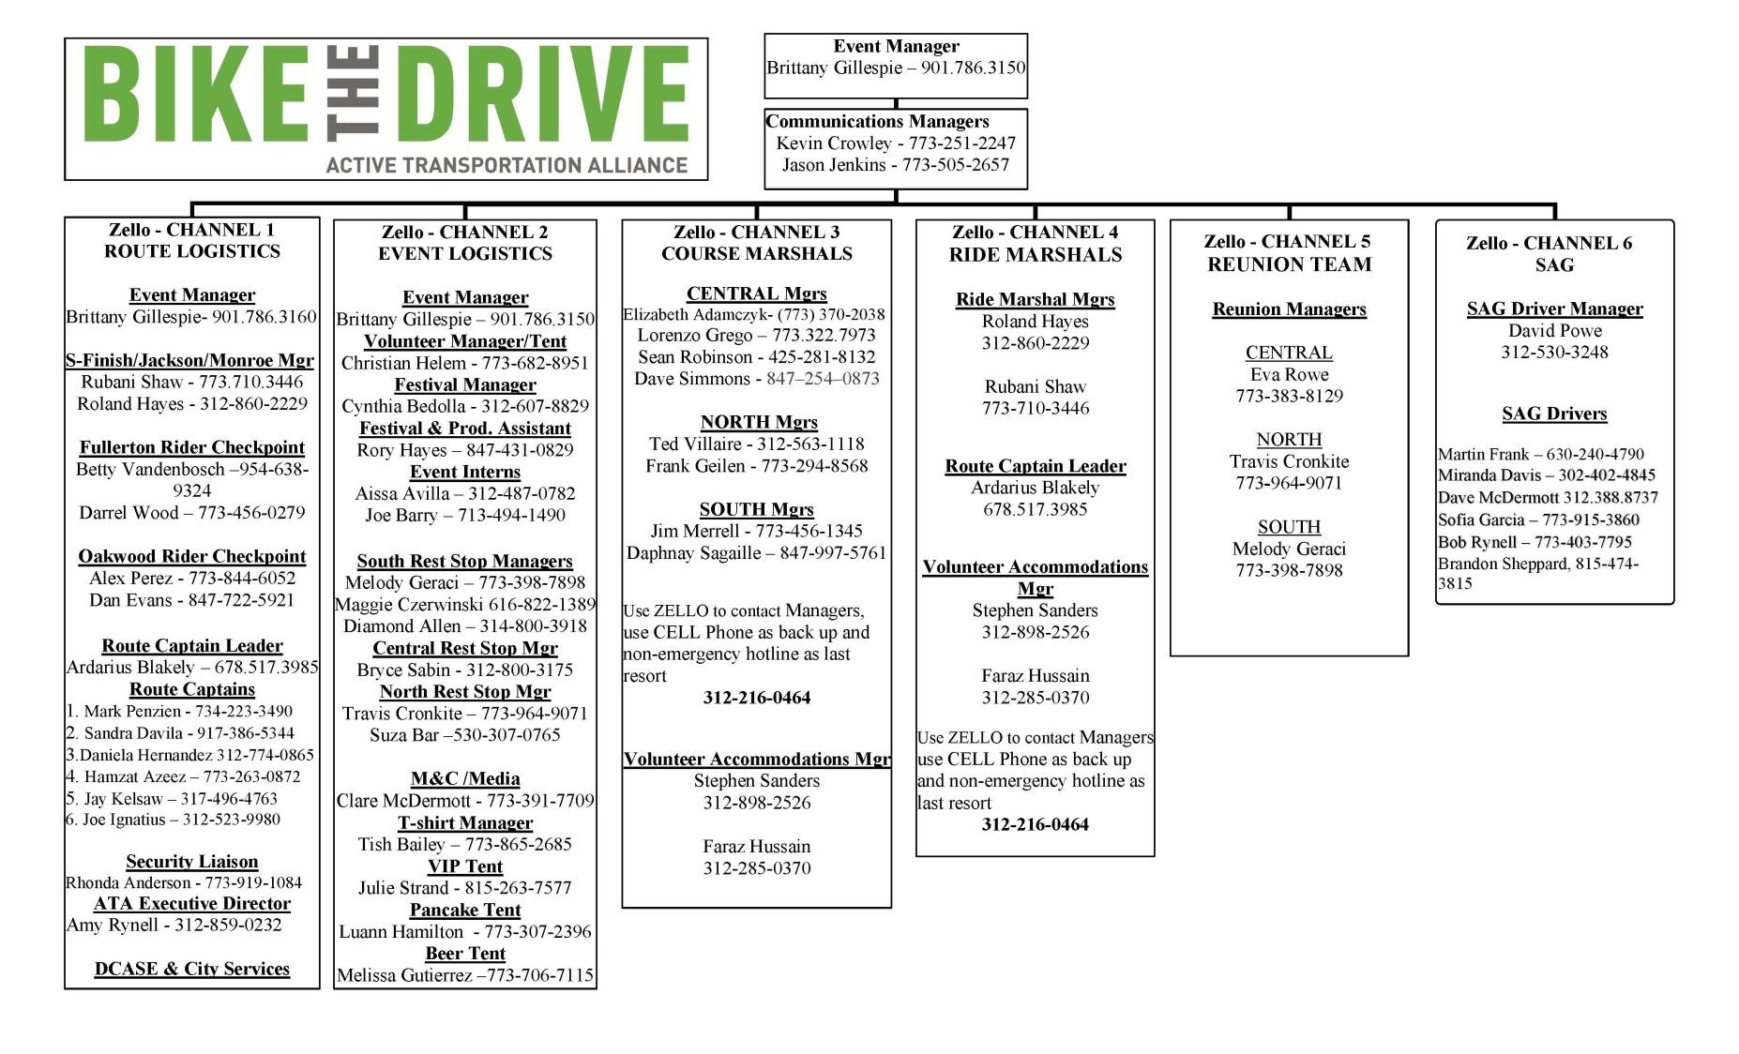

Slide 30
Incident Report, Bike Tag and Reunion
Incident Report- We’ve updated our incident reports to be more specific and reflective of what info is usually provided and what’s needed! We have a digital version that will be available via Zello on the morning of the event Make sure to get the Rider Number each time.
Bike Tag– Only used in the event that a rider gets transported off the course without their bike. We need to get the bike back to the owner!
Reunion– Seperate PINK form. Used in the event that a rider gets
separated from their group This can happen to people of many ages! Please remember to be kind and remind them that we always unite folx back together! :)

Slide 31
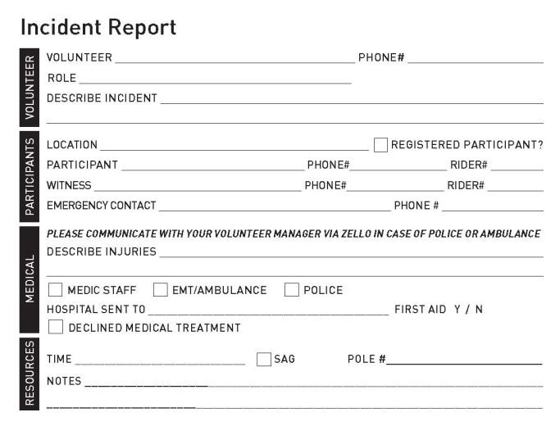
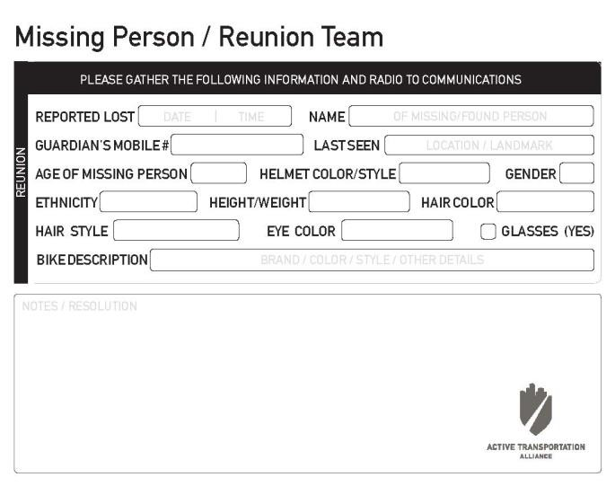
Take a look at them!

Slide 32
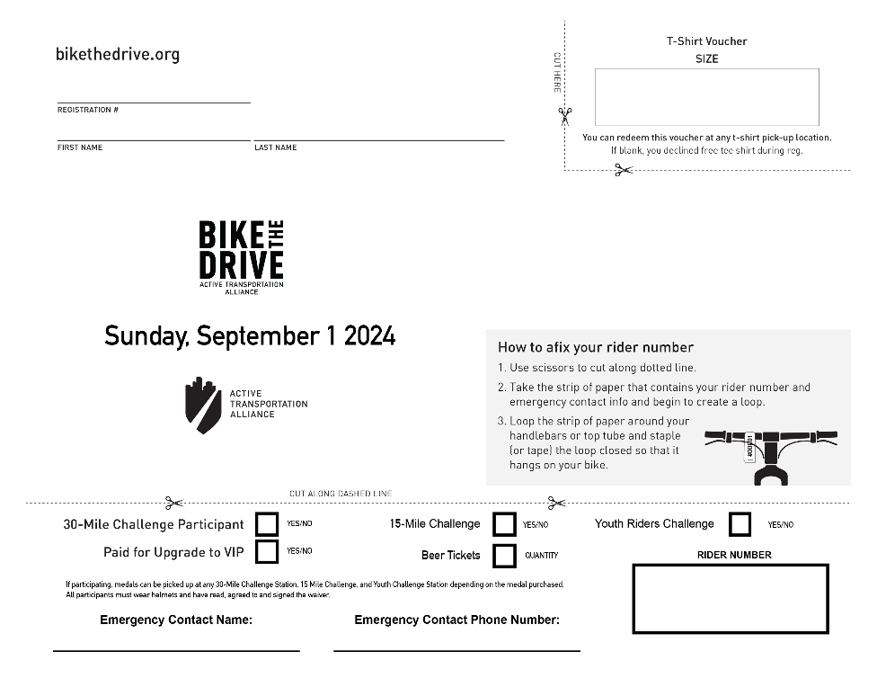
E-Tickets & T-shirt Pick Up
T-Shirts, Challenge medals & ride guides can be picked up at the following locations:
North Rest Stop
South Rest Stop
Festival

Slide 33
How can we have THIS much fun?
We’re a community! We’re all here to make sure BTD is enjoyable
If you aren’t sure...ask
Rules/Guidelines (ask your manager)
Everyone’s Pronouns
(he/she/they)
Lead with kindness to riders. If someone isn’t registered encourage them to do so. But if they don’t we will offer them
grace & let them continue.

Slide 34
What's Next?
Email from Volunteer Managers
You will receive a text message link to log into your channels

Slide 35
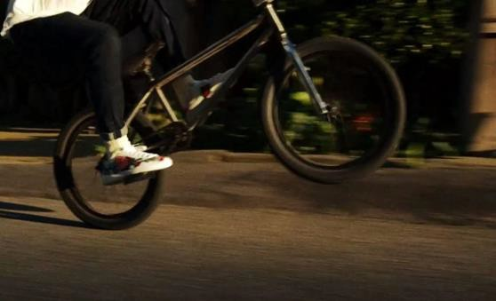
THANK YOU!!
Make sure to have fun and ensure our participants have fun too!
Stay safe! If you feel ill before the event, please alert your Manager ASAP! We'd rather have you home and safe!

Slide 36
Questions
Specific Questions: volunteer@activetrans.org

